Slide 1
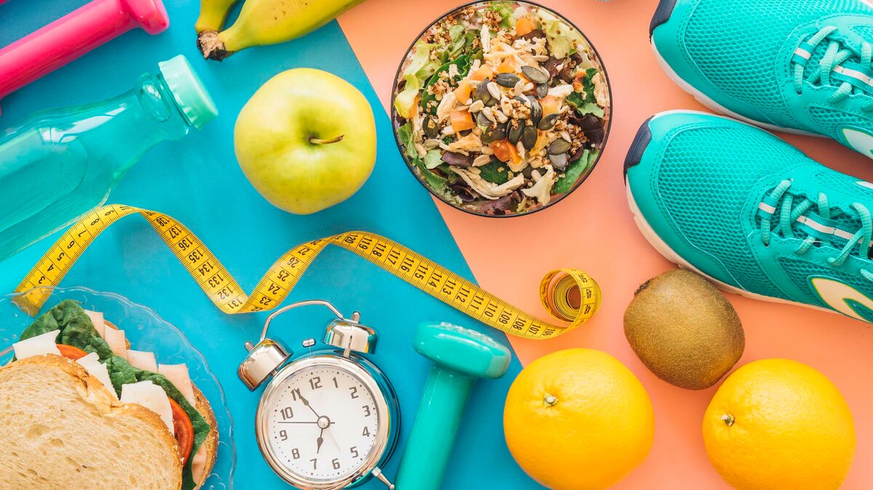
English
11Г

Slide 2
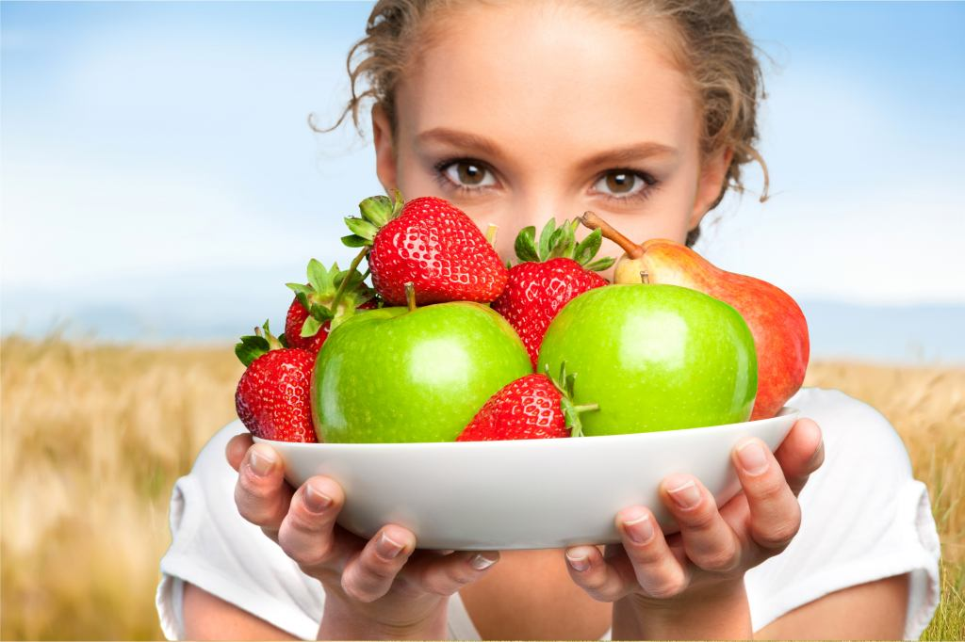

Slide 3
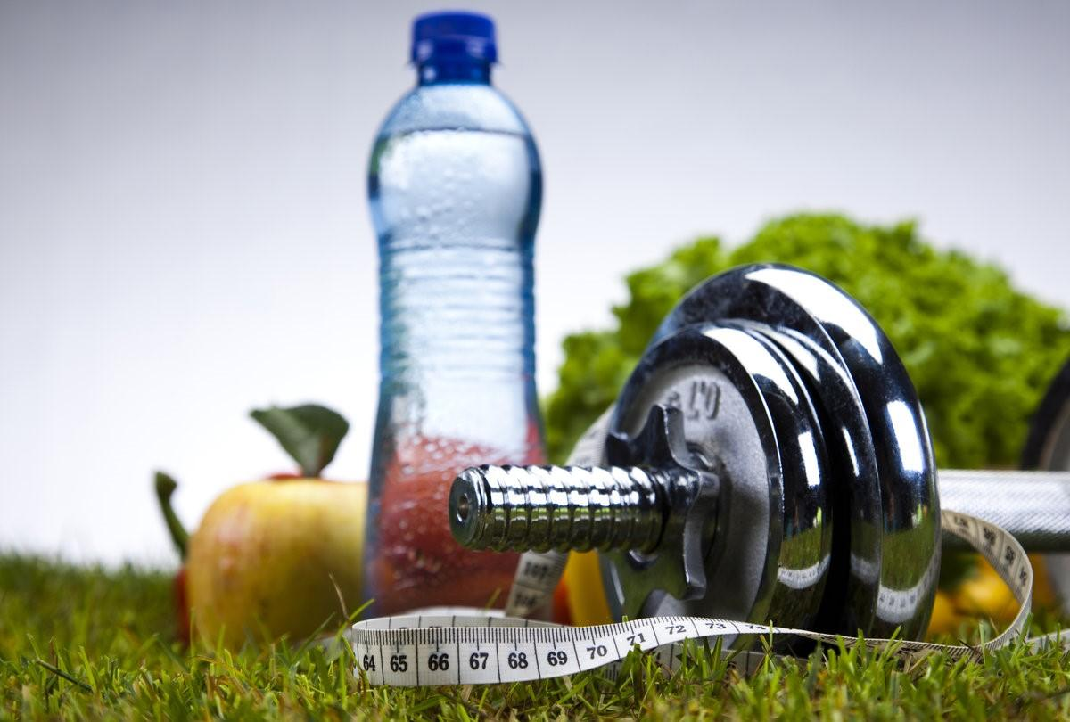
We are going to speak about
health,
health problems
and healthy way of life.
Today we must find out what is a healthy lifestyle.

Slide 4
It is a strong desire to take drugs, alcohol, cigarettes, food without being able to stop it…
fast food
(addiction)
addiction
The general condition of your body …
(health)
When someone is very fat in a way that is unhealthy…
(obesity)
health
Food such as hamburgers which is prepared quickly and that you can take away with you…
(fast food)
obesity
Causing or likely to cause harm..
(harmful)
poison
Heavier, bigger than one should be…
(overweight)
overweight
A substance added to food or drink to give it a particular flavor…
(flavouring)
harmful
A substance that can cause death or serious illness if you eat it…
flavouring
(poison)

Slide 5
1. Psychological addiction is when someone wants something which will change their mood or feelings.
2. Cigarette smoke contains chemicals, that are found in rat poison.
3. Junk food, if eaten often, can lead to obesity and other problems.
4. Unfortunately many people are overweight nowadays and they don’t understand why.
5. People don’t think that the taste they like so much is a careful combination of artificial flavourings and preservatives.
6. However it is important to understand that though fast food looks so nice and tasty it may be dangerous for your health.
7. Alcohol is very harmful to our health.

Slide 7
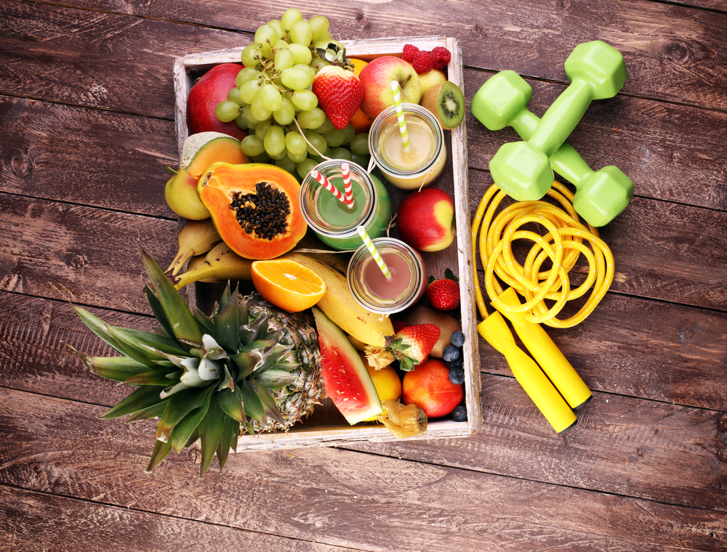
To be healthy you need…
To be healthy you shouldn’t …

Slide 8
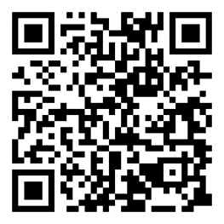

Slide 9
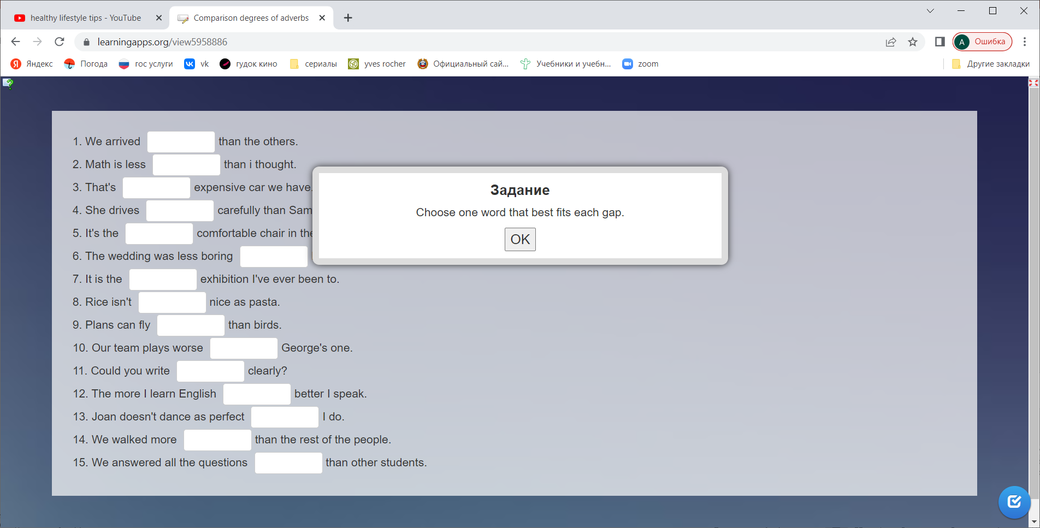

Slide 11
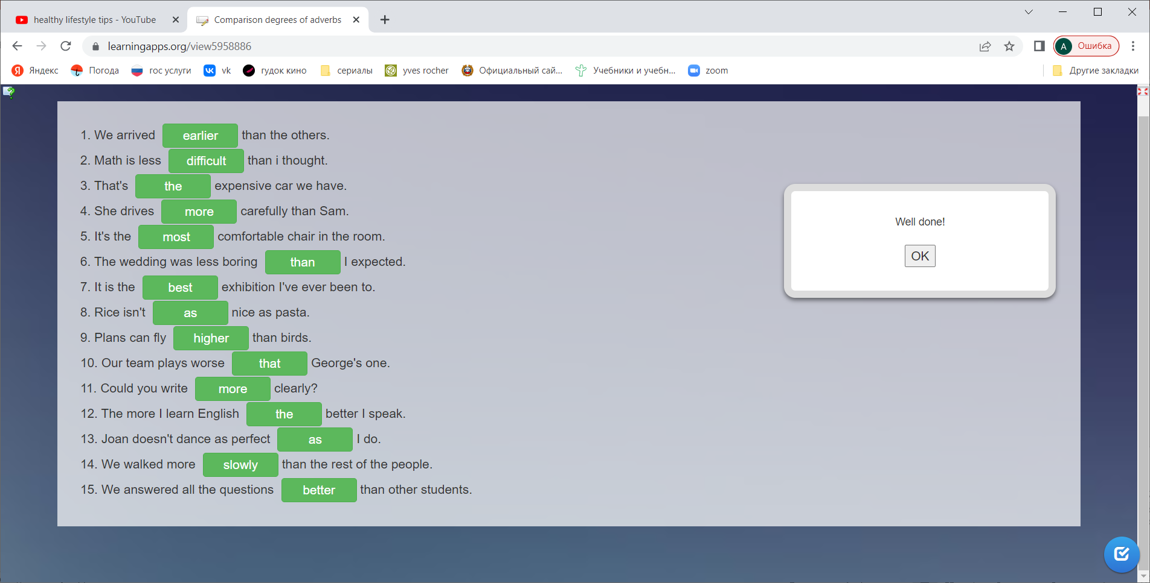

Slide 12
1. wealth is good above health
Good health is above wealth
2. a day apple an away keeps doctor a
An apple a day keeps the doctor away
3. to and healthy bed wise makes a rise man early and early to wealthy
Early to bed and early to rise makes
a man healthy, wealthy, and wise.
4. a mind sound in body a sound
A sound mind in a sound body
5. eat live to but, to eat not live
Live not to eat, but eat to live
6. he who has everything and has hope he who has hope has health
He who has health, has hope; and he who
has hope, has everything

Slide 13
